Slide 1
Zybo Z7-20보드를 활용한 MNIST MLP가속기 제작
7조

Slide 2
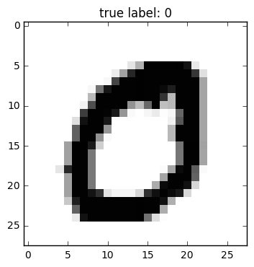
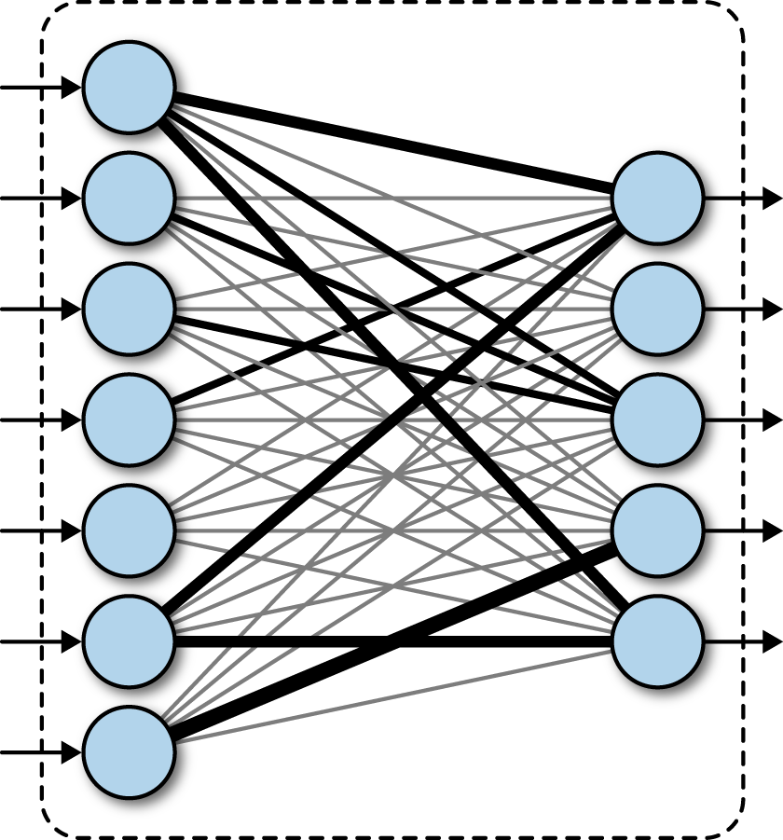
Elaboration – what do we need to do?
LAYER 1
LAYER 2
LAYER 3
784
1
256
1
128
1
128
10
W3
×
W2
×
128
256
W1
×
256
784
“0”
Flattened MNIST dataset
Fully connected neural network accelerator

Slide 3
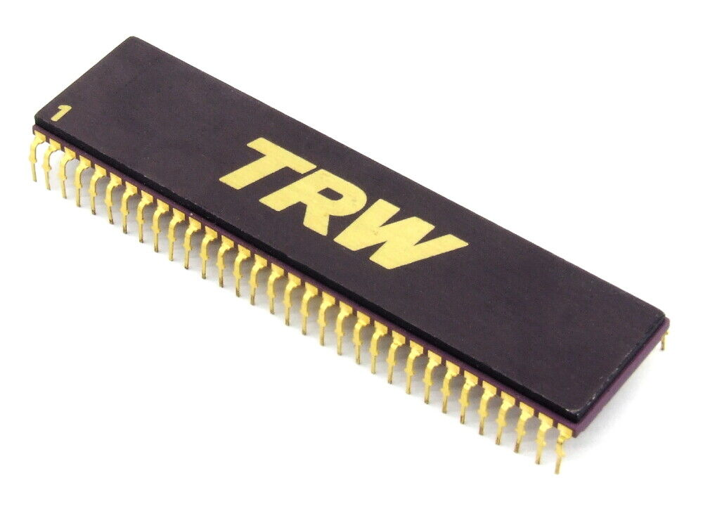
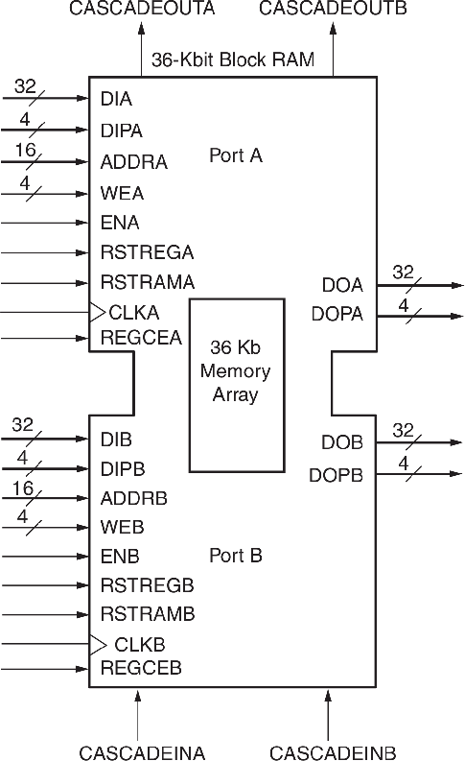
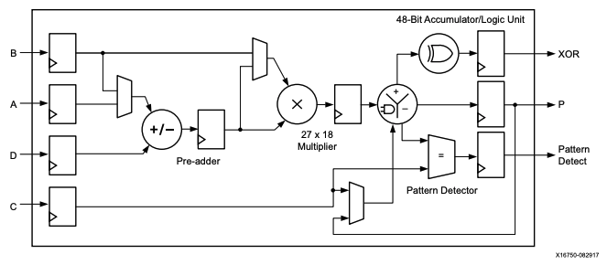
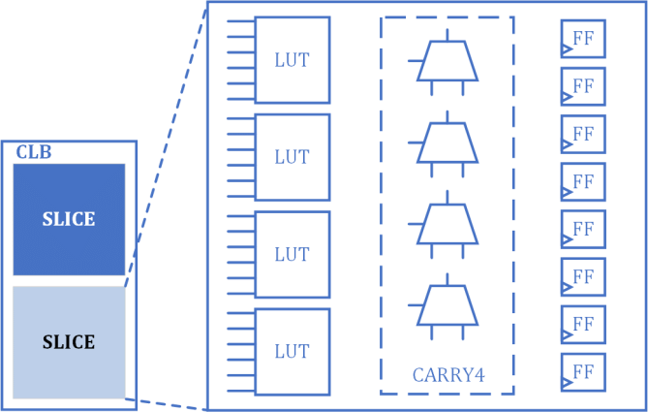
Elaboration – FPGA resources
DSP48E1
does math way too “fast”
than the TRW’s bipolar multiplier…
(165ns)
6-input LUT
3-operand addition fluently
RAMB36E1
supports TDP RAM
Z-7020

Slide 4
Basic ideas – matrix calc method
accumulation
serial dequantization/
quantization is compact, but slow
1 | 2 | 3 | 4
1 | 2 | 3 | 4
acc
1 | 2 | 3 | 4
1 | 2 | 3 | 4
1 | 2 | 3 | 4
1 | 2 | 3 | 4
acc
acc
acc
acc
1 | 1 | 1 | 1
2 | 2 | 2 | 2
3 | 3 | 3 | 3
4 | 4 | 4 | 4
parallel dequantization/
quantization is fast, but pricey
accumulation
serial dequantization/
quantization, can get result fast,
compact
matrix multiplication step
q/deq. step

Slide 5

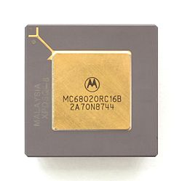
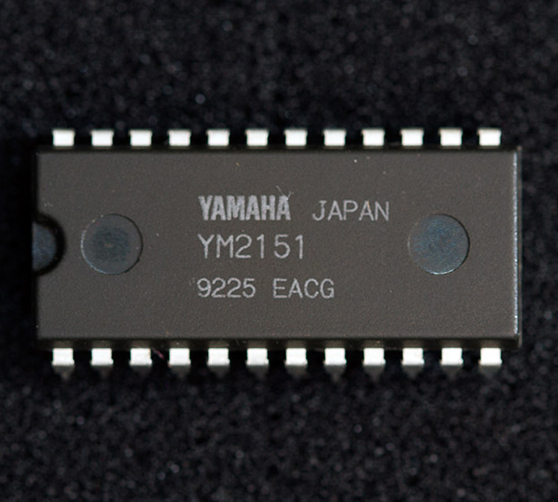
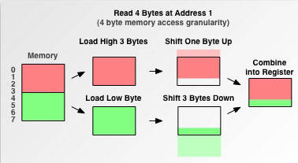
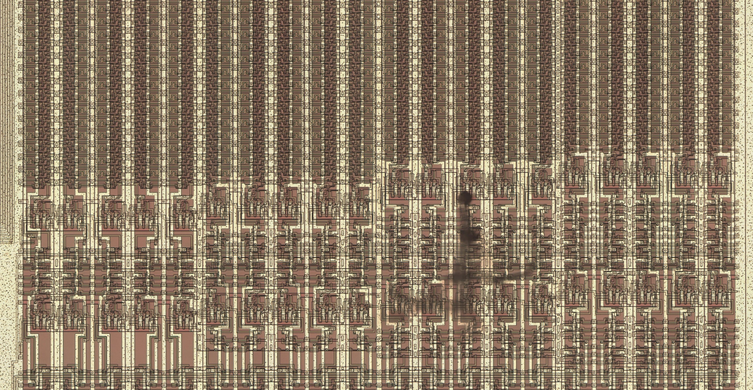
Basic ideas – implementation (from 80s)
32-bit microprocessor
MC68020(1984)
FM synthesizer
YM2151(1983)
…can fetch unaligned data
..takes advantages of SR’s “free addressing”

Slide 6
A unit using recursive architecture – plans
Does maximum 262 multiplications in single cycle
Infers a single image within 1000 cycles (8us@125MHz)

Slide 7
A unit using recursive architecture – block diagram
16B x 17stages
aligner
image ROM
control
sequencer
shift register
8*262 x 1k
8*262
weight ROM
image buffer
intermediate value buffer
8*262
DSP48E1 x 218
LUT mult. x 44
8*262
16*262
17*131
rounding
clipping
56
accumulator
quant./dequant. coefficient Q1.32
output buffer
DSP48E1 x 2

Slide 8
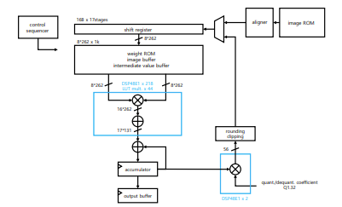

A unit using recursive architecture – description
16B x 17stages
“free addressing”
aligner
image ROM
shift register
8*262 x 1k
8*262
weight ROM
image buffer
intermediate value buffer
16
16
256
6
262 bytes(cyc1)
misaligned!
16
250
12
262 bytes(cyc2)
244
16
260 bytes(cyc3)

Slide 9
A unit using recursive architecture – description
Use true dual port(TDP) RAM
to maximize time efficiency
weight ROM
image buffer
intermediate value buffer
8*262
DSP48E1 x 218
LUT mult. x 44
8*262
LUT6 can handle 3-op addition quite well
3-op adder tree will decrease pipeline steps!
16*262
Implement 8 by 8 multiply-add blocks
using DSP48E1 to save LUT resources
Synthesis attributes would be needed
Vivado will turn a simple 8*8 multiplier into a ton of LUTs
17*131
accumulator
output buffer

Slide 10
A unit using recursive architecture – description
16B x 17stages
shift register
Used Q1.32 format to increase accuracy
The effect is small(<1%), but more resource efficient than Q16.16
rounding
clipping
56
quant./dequant. coefficient Q1.32
DSP48E1 x 2

Slide 11
A unit using streamline architecture – plans
Layer 1 – 384 multiplications per 1 cycle
Layer 2 – 64 multiplications per 1 cycle
Layer 3 – 10 multiplications per 1 cycle
w/ parallel accumulation
First image output latency < 2000 cycles (16us@125MHz)
Calculation cycles = 512 cycles (4.1us@125MHz)

Slide 12
A unit using streamline architecture – block diagram
SIPO shift registers
Load data serially
IMAGE FETCH
LAYER 1
LAYER 2
LAYER 3
Image ROM/
preprocessing
W3 ROM
PISO shift register
rounding/
clipping
PISO shift register
rounding/
clipping
accumulator
W1 ROM
W2 ROM
quant./dequant. coefficient Q1.32
quant./dequant. coefficient Q1.32
output buffer
Use single quant./dequant. coefficient

Slide 13
Specification – processing time: recursive vs. streamline
 | Recursive | Streamline
Output latency | 999 cycles (8us@125MHz) | 1848 cycles (14.8us@125MHz)
Cycle time | 999 cycles (8us) | 524 cycles (4.2us)
Throughput time (10 images) | 10001 cycles (80us) | 6299 cycles (50.4us)
recursive
L1
L2
L3
L1
L2
L3
L1
L2
L3
999 cycles (8us)
999 cycles (8us)
total 10001 cycles (80us)
streamline
IF
IF
IF
L1
L1
L1
L2
L2
L2
L2
L3
L3
L3
L3
1848 cycles (14.8us)
524 cycles (4.2us)
total 6299 cycles (50.4us)

Slide 14
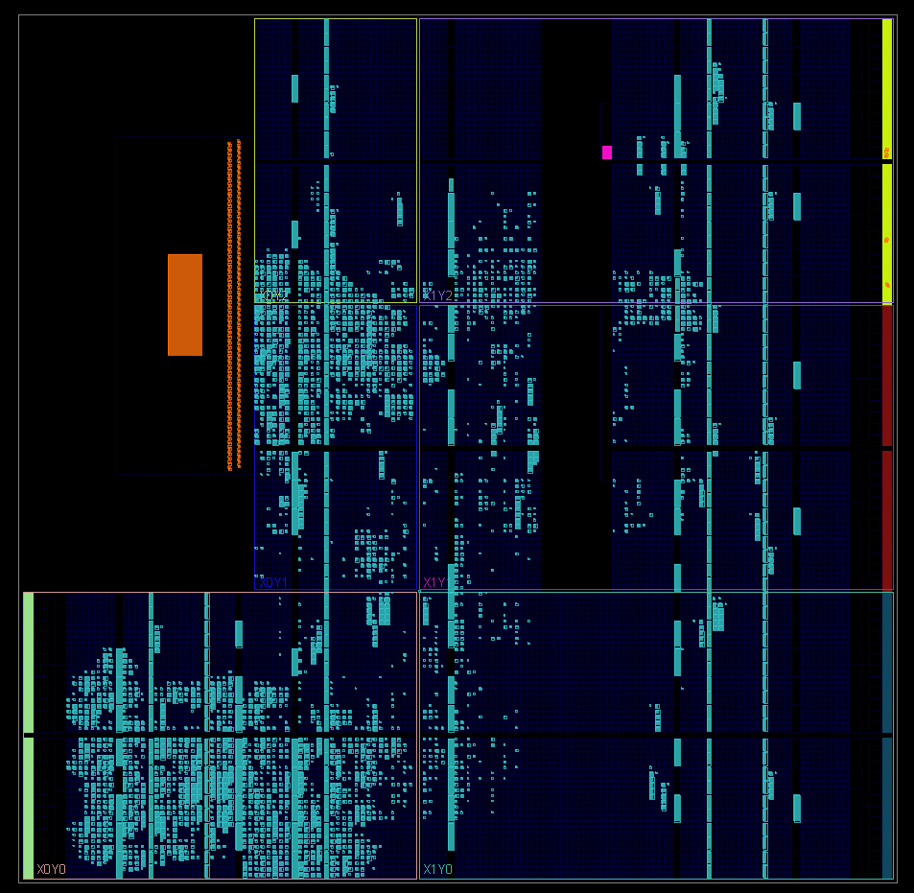
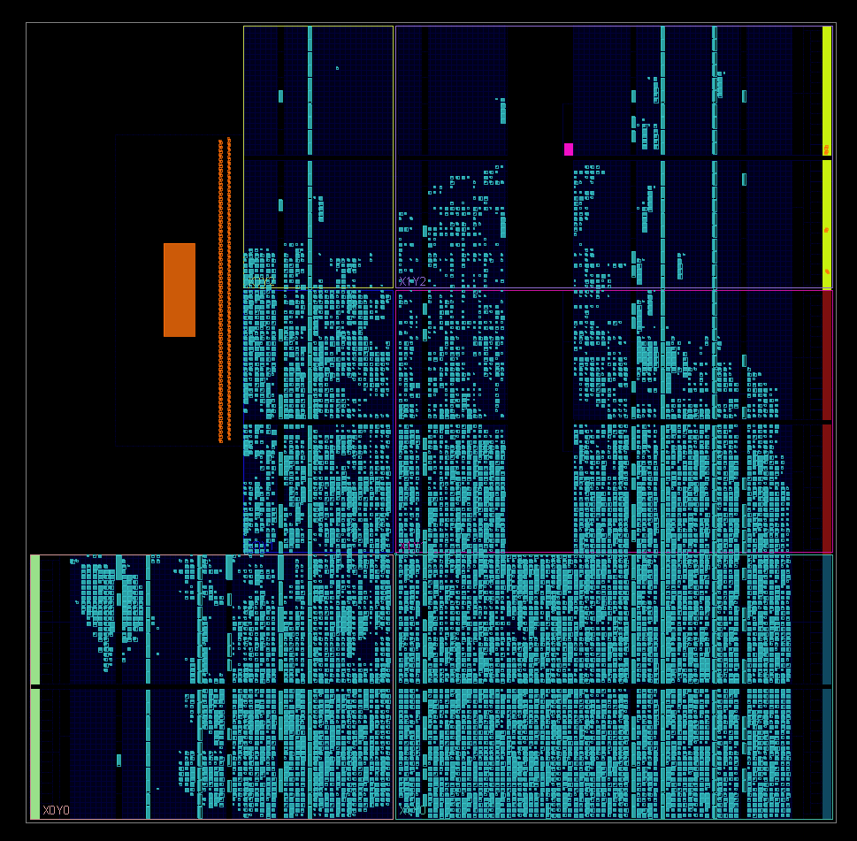
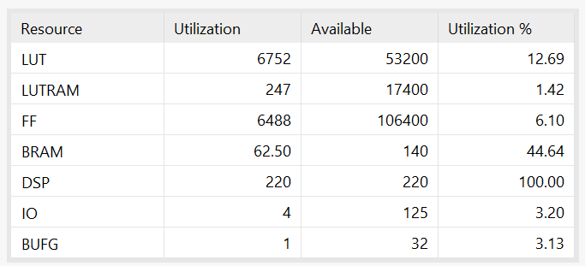
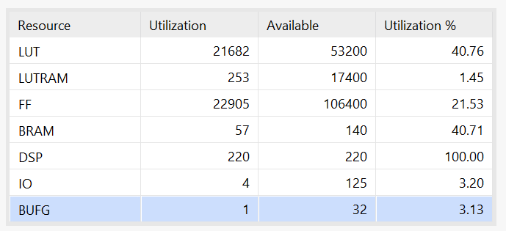
Specification – resource usage: recursive vs. streamline
RECURSIVE
STREAMLINE
Floorplan(automatic)
Floorplan(automatic)
Logic utilization
Logic utilization

Slide 15
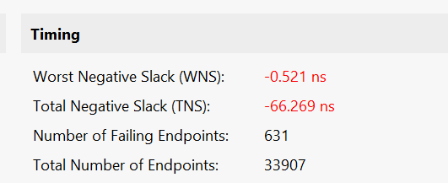
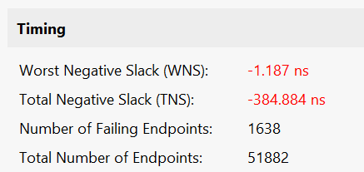
Specification – timings: recursive vs. streamline
No compilation option! default settings
RECURSIVE
STREAMLINE
Setup timing WNS: -0.521ns
(the slowest silicon under the worst operating condition)
Setup timing WNS: -1.187ns
(the slowest silicon under the worst operating condition)
Clock cycle = 8ns
Reported maximum delay = 8.5ns / 9.2ns
Slowest path exists
inside a 8x8 signed multiplier
Implemented as LUTs
DFF
DFF
DFF

Slide 16
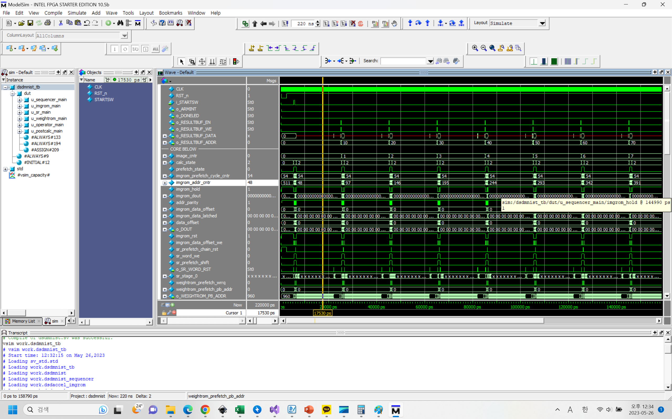
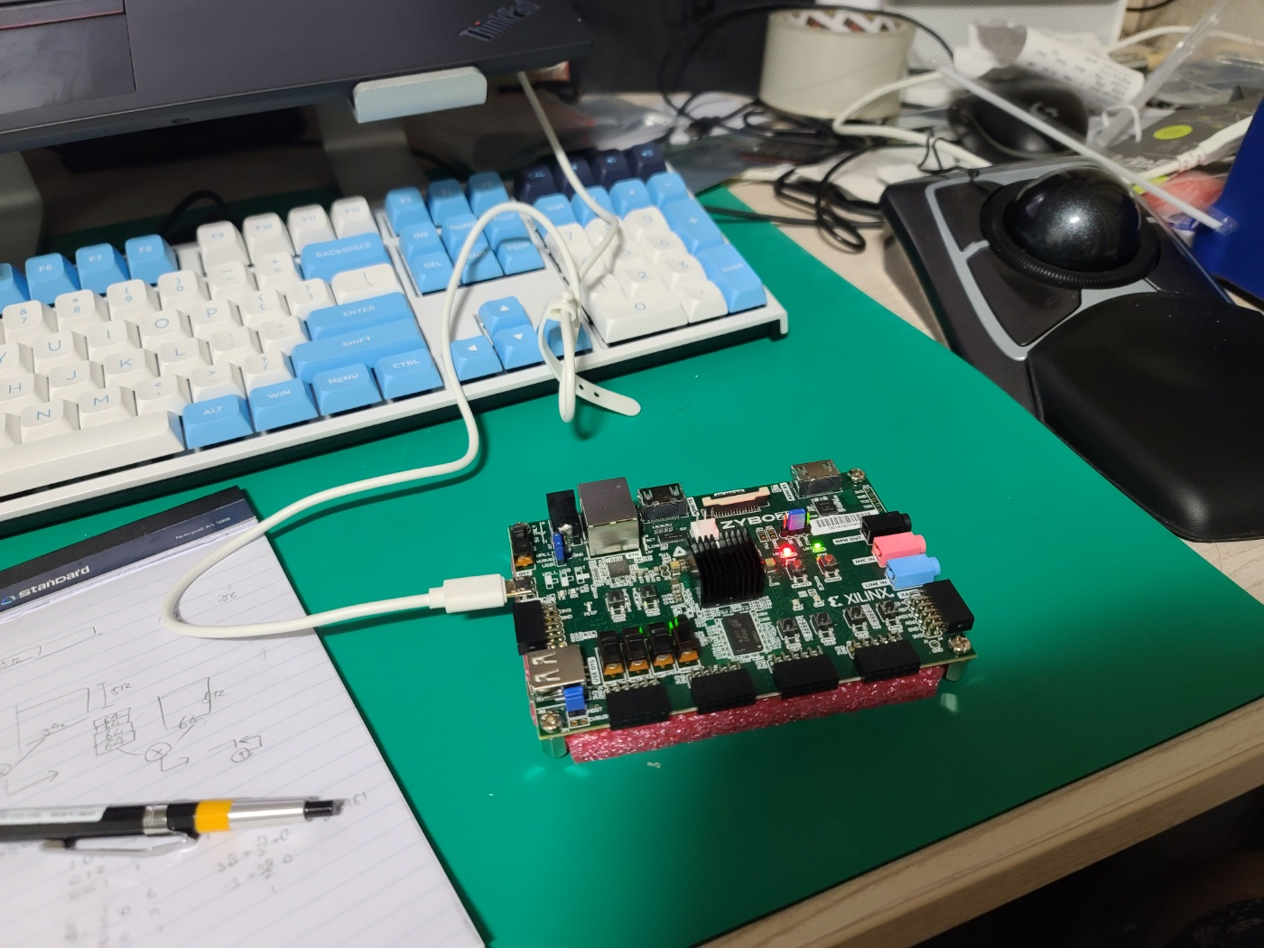
Postscript – development process
Used Modelsim for simulation
Everything worked as expected! - no hardware debugging session
So fun
I hate Vivado

Slide 17
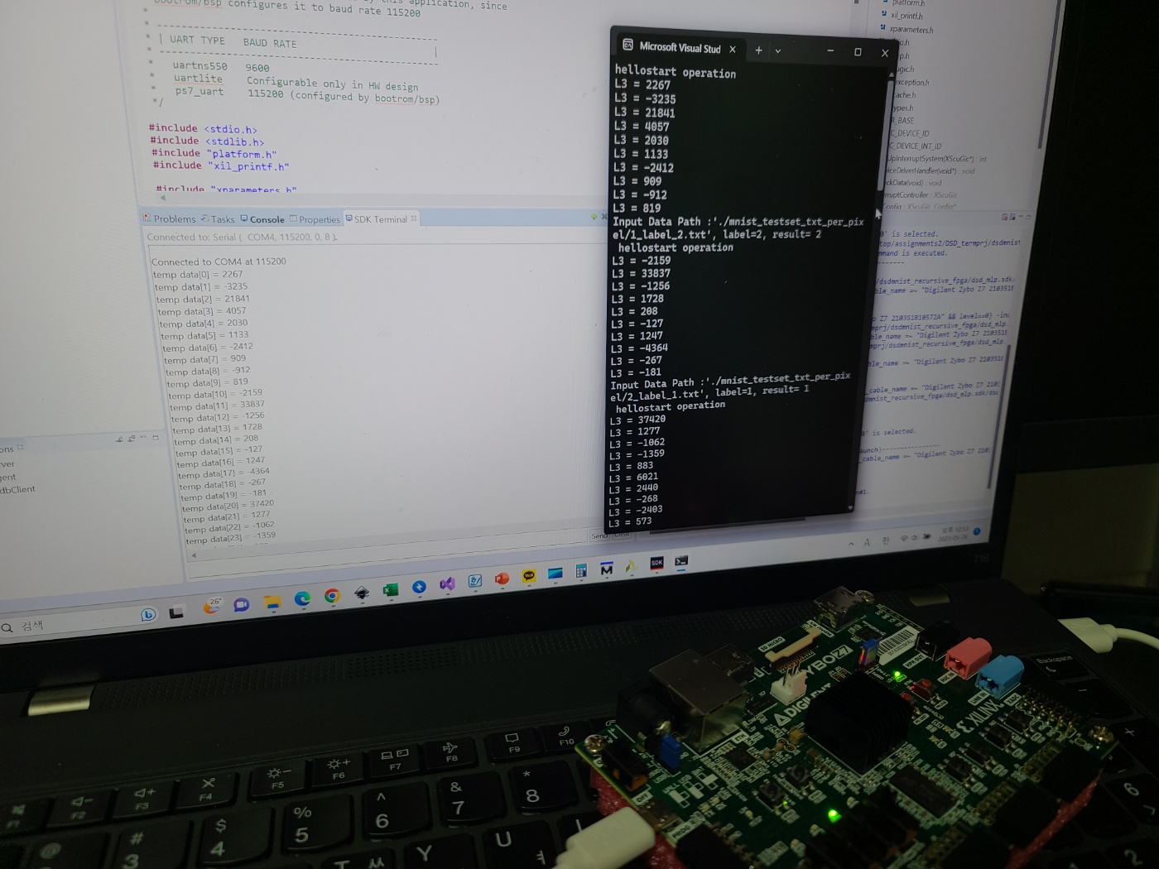
Postscript – development process
Used SystemVerilog for ease of development (can declare 2D/3D array port)
Hardware verification was simply done by comparing the terminal outputs with the execution result of the C reference code

Slide 18
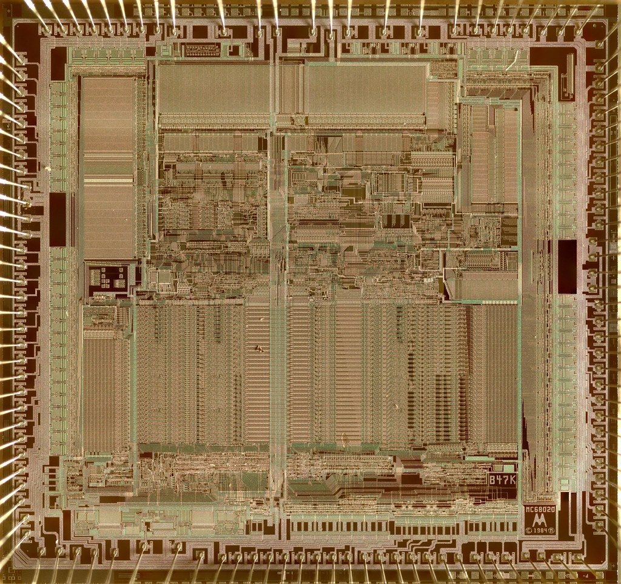
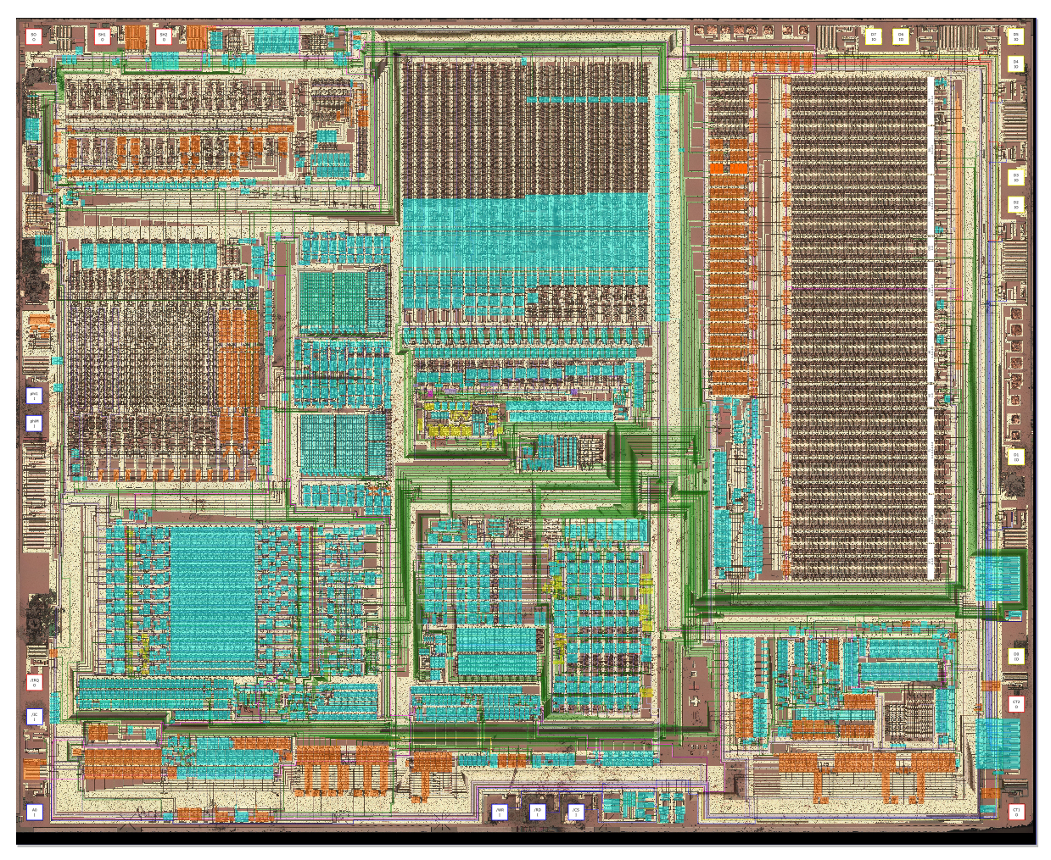
Thank you
MC68020 – Motorola(1984), 2um CMOS process
(decapped, to be imaged)
YM2151 – Yamaha(1983), 3us NMOS process
(github.com/ika-musume/IKAOPM)

Slide 19
cropSheet()
이미지 입력
HSV분리
과목 판별
evalSubject()
경로가 짧은 쪽을 선택
과목별로 OMR마킹 체크
eval*()
isMarked()
alignSheet()
경로의 꼭짓점 탐색
코너 마커 찾기
답지 txt와 비교
compareSol()
1차 perspective transform/crop
2차 perspective transform/crop
결과 출력

